Slide 1
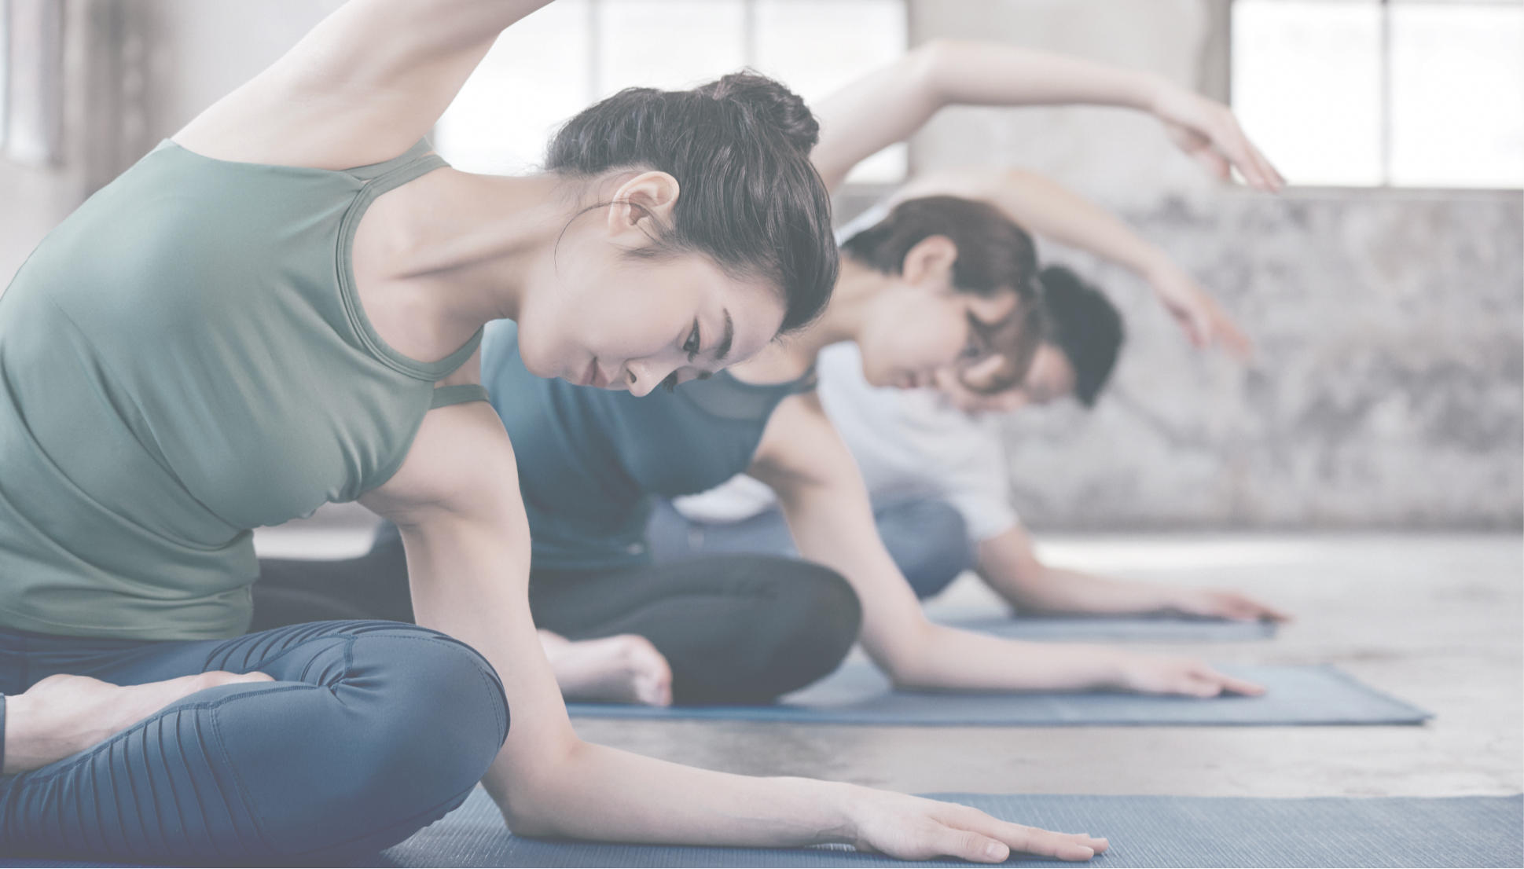




Notes:
Hello, this is team M, and I’ll be going through tasks we've been doing for couple of weeks.

Slide 2
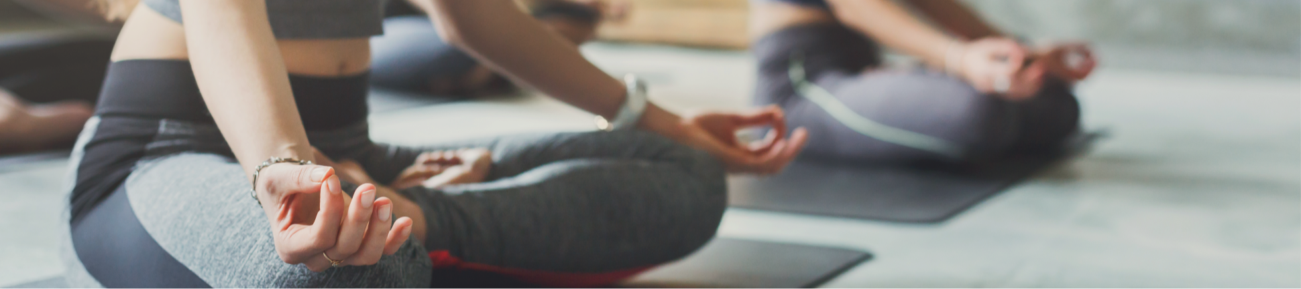




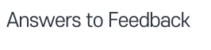

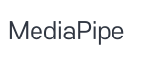

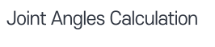

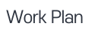
Notes:
I’ll quickly recap about our topic, review and answer feedback, and explain our tasks.

Slide 3

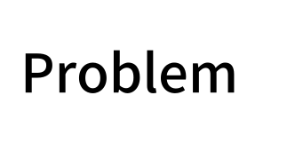
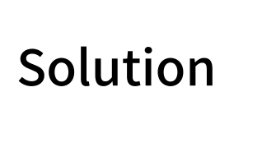
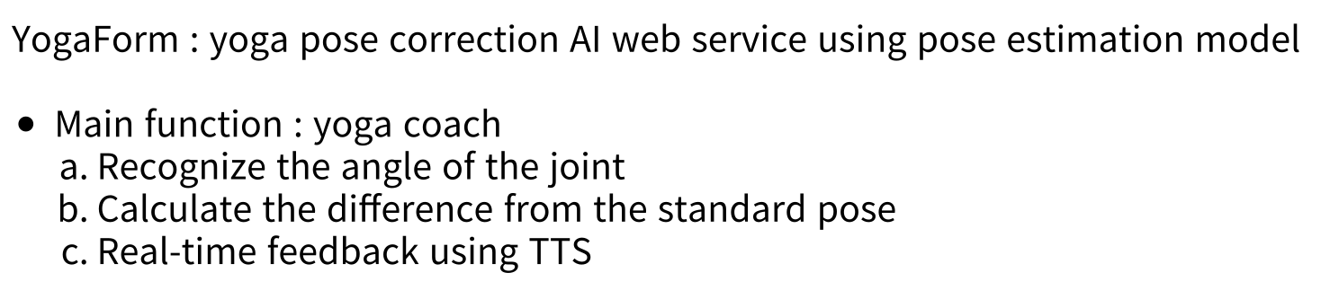
Notes:
I hope not, but I know that most of you won’t remember out topic.
Our team focused on yoga and found a problem that it’s hard to tell if the posture is correct doing yoga alone.
So we introduced yogaform, yoga posture correction AI web service.
Our main function is yoga coach, which recognize user’s joint, calculate the difference of the joint’s angle and give feedback using TTS.

Slide 4



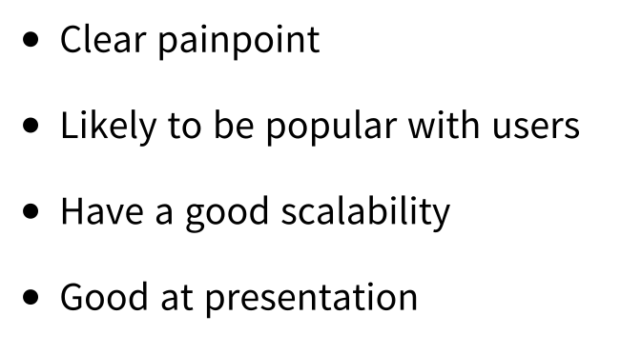
Notes:
After the proposal, we’ve organized some feeadback we got. I’ll go with the compliments first.
Our concept of problems, solution and scalability seemed to be well delievered.
And there was couple of compliments about my speech. I appreciate that.

Slide 5
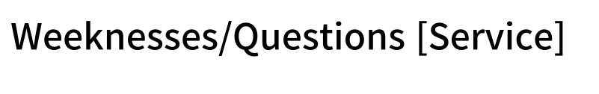
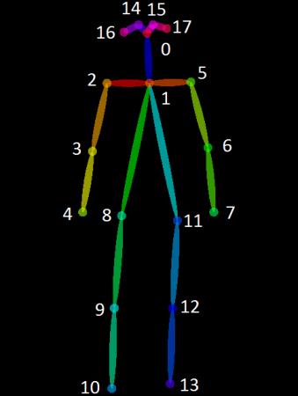


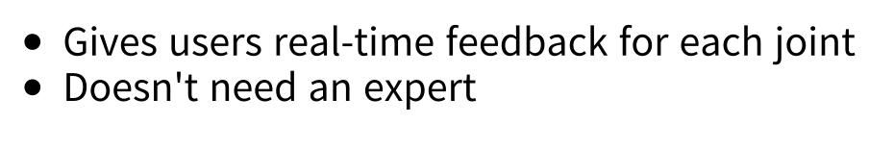

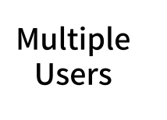

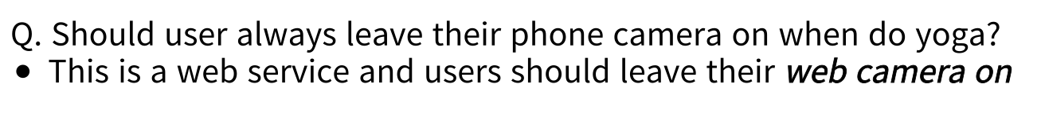
Notes:
And about questions and concerns, we divided it into two categories.
In Service point of view. there were three main questions.
Some asked about the difference with existing services. As I mentioned in proposal, existing yoga service Mixpose also detect pose.
Yet, they can’t give real-time feeadback by detecting it.
They need an instructor to mannually give feeadback. Our service will give by detecting it and calculating the angle by itself, so no need of an expert in advance.
Also, there were questions of multiple user. We did discussed about it but we chose to focus on single user.
Most importantly, we target self-yoga people at home, so majority of users will be alone.
Moreover, when they turn on the labtop camera, it won’t be able to put two people’s whole body in one frame.
In technic point of view, yolov7 can detect multiple users. Though they could only detect 17 body landmarks while mediapipe detects 33.
So with several reasons, we will be focusing on single user.
And there was a question about user experience, should user always leave their phone camer on when doing yoga.
As I mentioned in proposal, we are gonna make a web service, and user’s gonna have to leave their web camera on.
And even if we can make modbile app somehow, you r going to put your camara on to use the service.

Slide 6
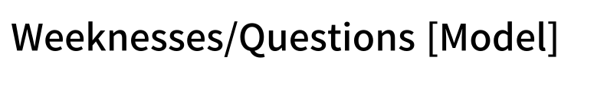


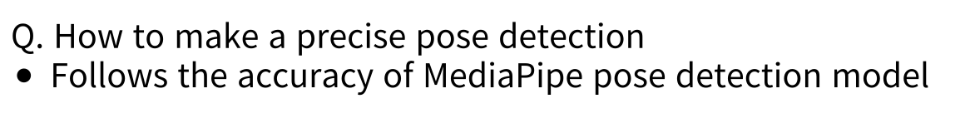

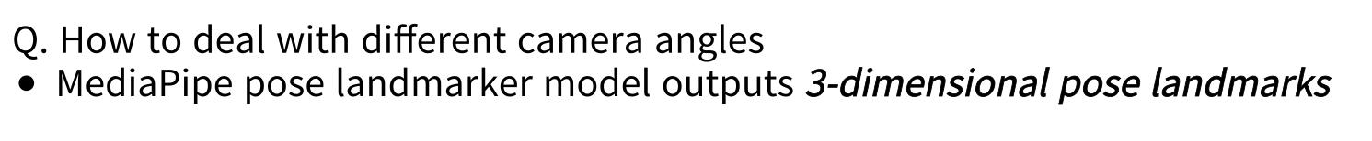
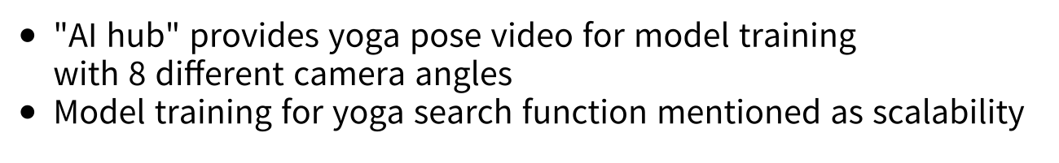

Notes:
Nextly, in Model point of view. there were also three main questions.
Some team wondered about our model’s accuracy.
To briefly explain, for our main function, we are utilizing the model, not fine-tuning it.
We are utilizing Google’s mediapipe model so we’ll follow the accuracy the model can achieve. We believe in Google, and so far it showed reasonable accuracy.
And the second main question was about angle. As even professor mentioned after proposal, many teams asked about this issue.
To get to the point first, we believe that it’s not going to be a problem, because Mediapipe recognize pose in 3-dimension.
We will let them set the camera angle as we want, then we’ll use their joint’s x,y,z coordinates to calculate vectors angle.
So even if it looks like 2D-detection on the camera, it calculates human angle in 3D.
As for right now, we didn’t face any problems yet, and if we face one, we will discuss it in next weekly presentation.
The last concern was about data we’re using.
We had presented the screenshot of video data in proposal. That yoga pose video is provided by Ai hub, which is collected to be used for model training. It had 8 different camera angle data.
Despite the data, as we also explain before, the training part is to let the model know the pose and this function is for yoga search.
Yoga search is function mentioned as scalability, and our main function is yoga coach which does not need to train with this data. (It calculates the diff with the correct angle and saying it.)
If we have enough time to build this additional function, then we will use the data.

Slide 7

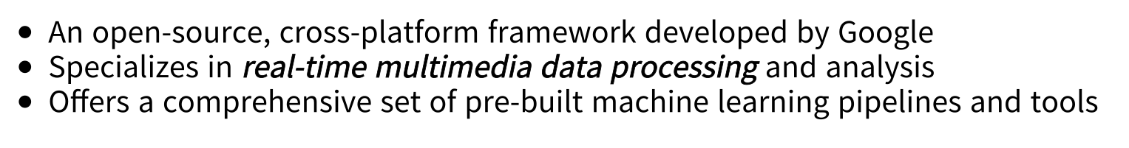
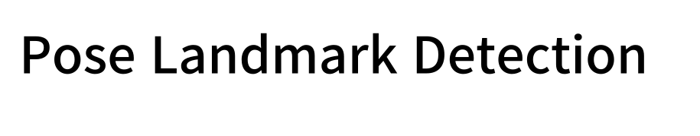

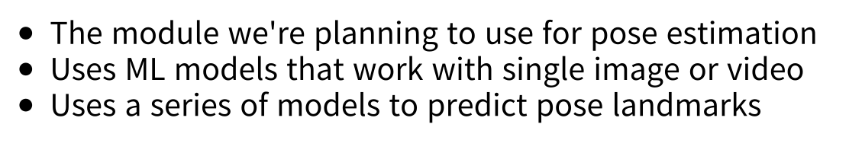
Notes:
When reviewing technical feedback, I mentioned about mediapipe a lot. I’ll explain what it is and how it works as for now.
Mediapipe is an open-source, cross platform framework developed by Google.
It is specialized in real-time multimedia data processing and analysis and offers a comprehensive set of pre-built ML pipelines and tools
such as face detection, hand gesture detection and et cetera.
The module we’re planning to use in mediapipe is pose estimation module.
It is introduced that it uses ML models that work with single image or video, and I’ll show you how well it detects human pose
It uses a series of models to predict pose landmarks and I’ll describe about it in following slide.

Slide 8
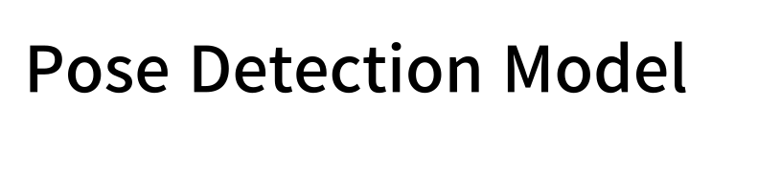
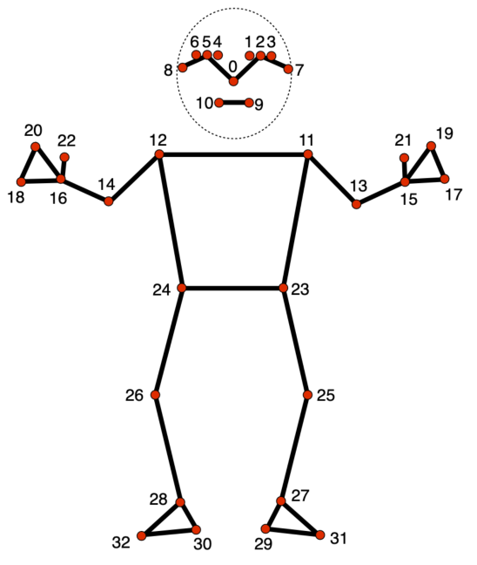
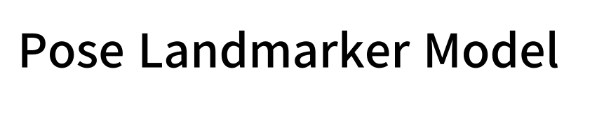
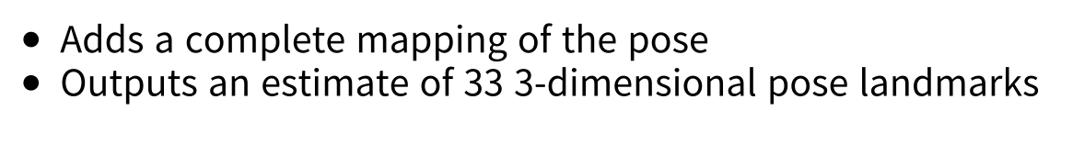
Notes:
This detector-tracker pipeline is what mediapipe pose estimation module is consisted of.
Firstly, pose detection model literally detects a body. Obviously module won’t be able to estimate pose with there is no body detected.
Then Pose landmarker model start finding pose landmarks and complete mapping based on BlazePose 33 landmark topology.
It will estimate 33 landmarks in 3dimension.

Slide 9
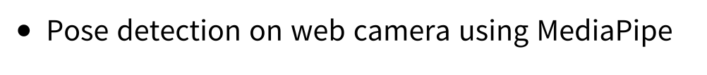
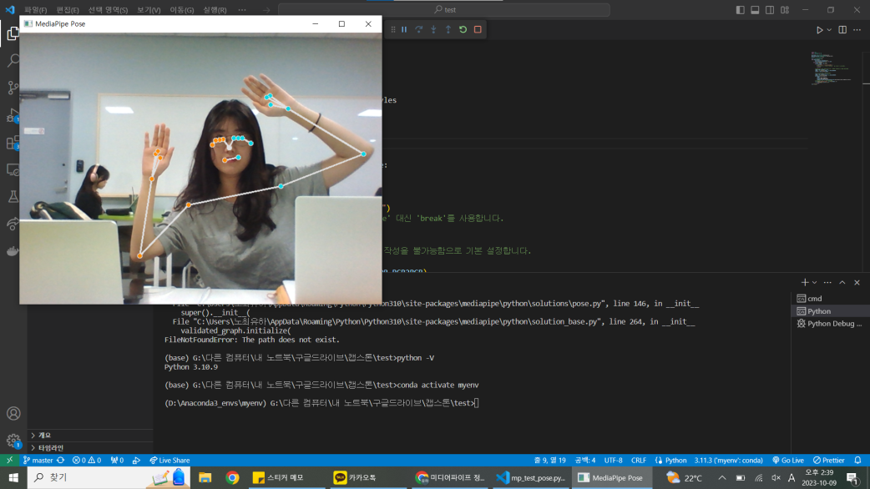
Notes:
Last week we implemented mediapipe with webcam.
This is one screenshot of our test.
You can see it detects human pose well eventhough there’s only part of body shown.

Slide 10

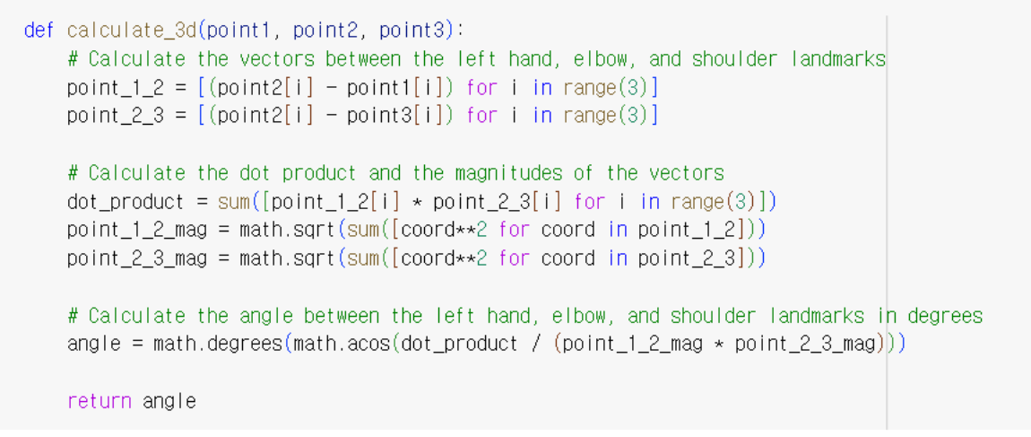
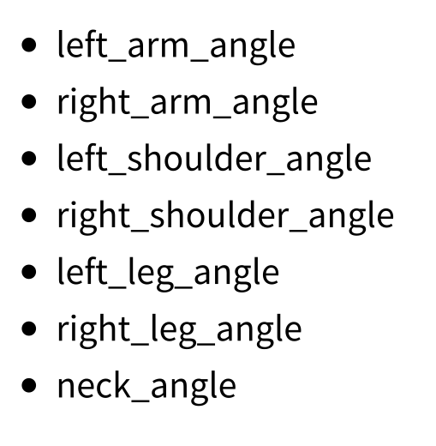
Notes:
After successful test with webcam, we started to build the function for yoga coach.
We implemented the joint angles calculation function.
To start with, we chose a few joints that is important in yoga poses.
We thought that at first, left and right arm, shoulder, leg and neck angle is critical to perform yoga pose correctly.
This code is about calculation using 3d coordinates.
Point 1 2 3 is joint points, and then it calculates joint 1-2, and 2-3 x y z angle vector.
Then calculates angle from the two vectors.

Slide 11
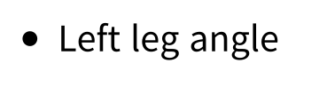
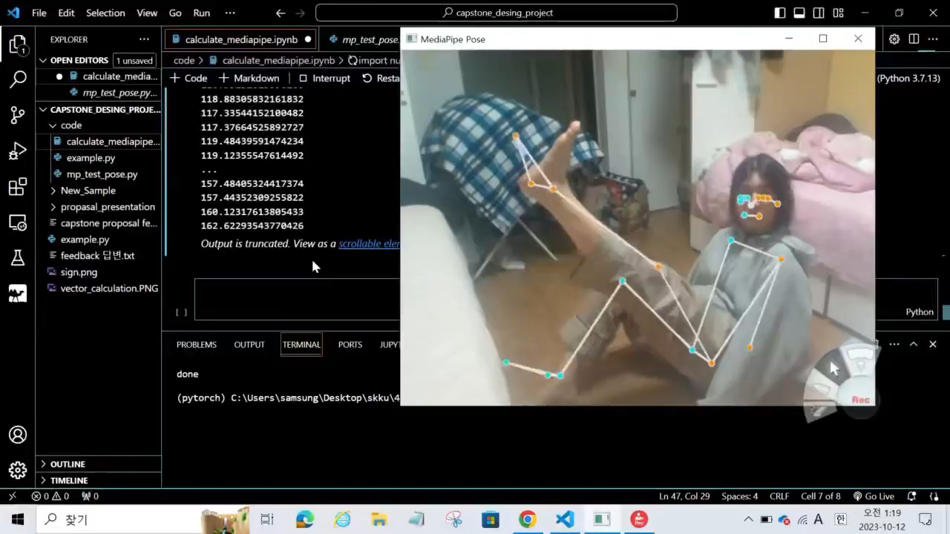

Notes:
We tested the function with one of our teammate. It’s a short clip testing left leg angle.
You could see that mediapipe detected human pose well.
And the log it’s giving is calculated angle per frame.
We made it to return values as log as for now, so when we start to make a web , we’ll deal with it in backend.

Slide 12

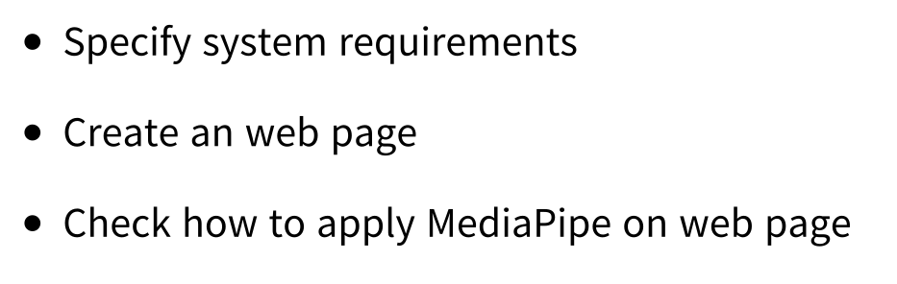
Notes:
For next week’s plan, we’ll specify system requirements so we can make core functions first.
We’ll start building website and apply mediapipe.

Slide 13
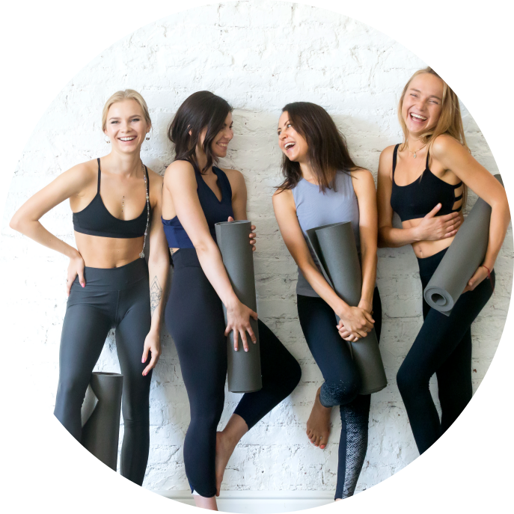

Notes:
Thank you for your attention.

